Slide 1

Portfolio.
- **[Wezeso]** - UI/UX & Branding Designer
- **[Sardor]** - Full-Stack Developer
- **[Alikhan]** - Backend Developer
- **[Amirkhan]** - Frontend Developer"

Slide 2

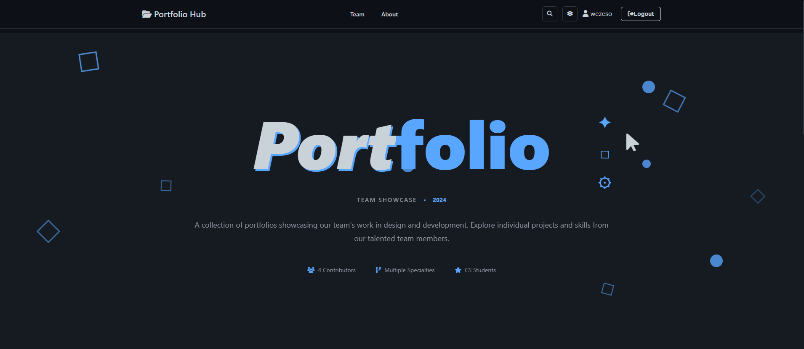

"Our main goals were to:
- Create a professional platform to showcase our individual skills and projects
- Demonstrate modern web development practices
- Build a fully responsive website that works on all devices
- Implement interactive features like search, filtering, and authentication"
**SLIDE 2: Project Overview & Goals**

Slide 3
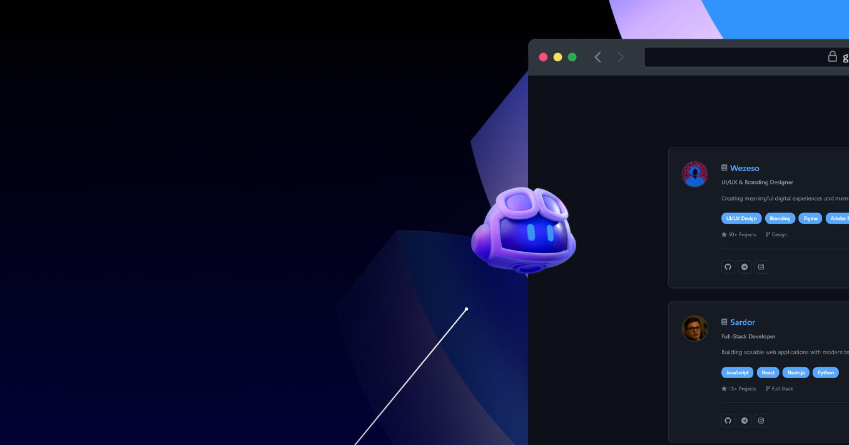
This project was inspired by the collective need for a professional, unified presence to present our diverse skills as Computer Science students.
Who We Built It For: Target Users
Potential Employers
Future Clients
Offering a centralized, high-quality viewing experience of our collective and individual capabilities.
Demonstrating our expertise through live examples of project execution and design proficiency.
Fellow Developers
Providing a resource for inspiration, open-source code exploration, and collaboration opportunities.
**SLIDE 3: Target Users & Inspiration**

Slide 4
**SLIDE 4: Main Hub Page & Design Aesthetics**

